Slide 1
Predicting Obesity & Overweight Prevalence In US

Slide 2
Project Overview
Goal: Predict obesity/overweight rates using demographic data
Data Source: CDC Behavioral Risk Factor Surveillance System
Target Variables: Obesity (Q036) and Overweight (Q037) prevalence

Slide 3
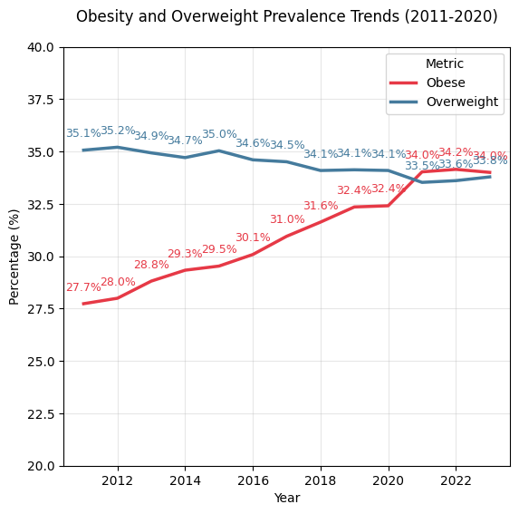

Slide 4
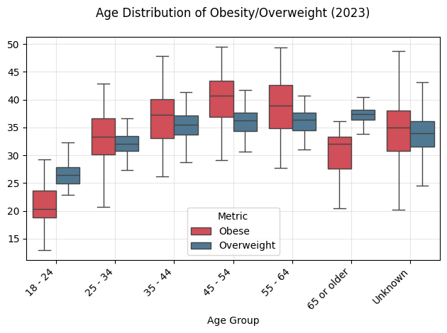

Slide 5
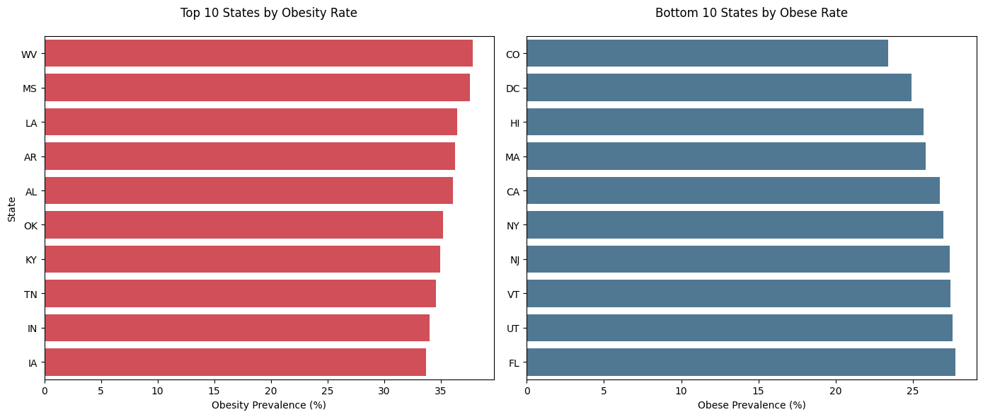

Slide 6
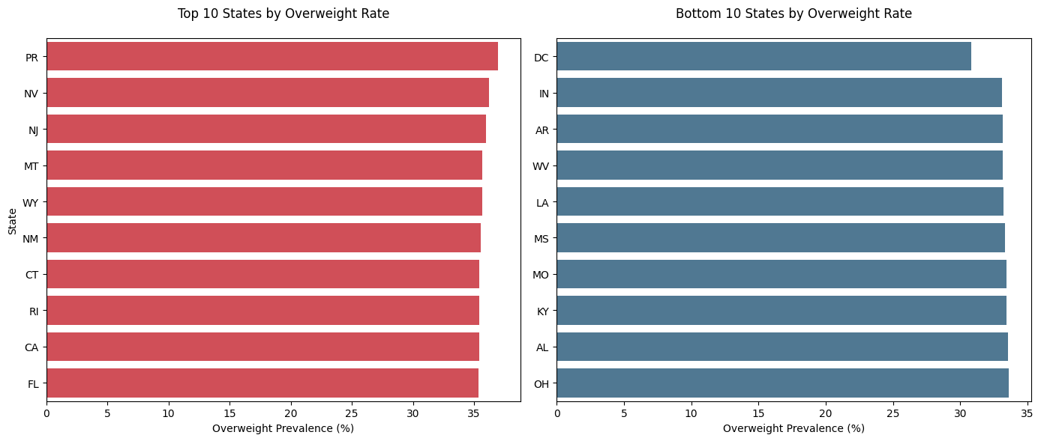

Slide 7
Modeling Approach
Linear
interpretable coefficients
Ridge
Handles multicollinearity, prevents overfitting
Random Forest
Handles non-linearity, robust to outliers
XGBoost
Handels missing values better

Slide 8
Key Findings
For Obesity and Overweight Prediction the best model was XGBoost
 | Mean absolute error | R^2 | Top Predictors:
Obesity | 3.09 (Average) | 0.705 (Good) | Age (18-24) Race/Ethnicity (Asian) State (Colorado)
Overweight | 2.31 (Good) | 0.47 (Average) | Sex (Male) Age (18-24) Income (<$15K)

